Slide 1

IE300-IE400
Industrial Practice I-II
2026
Dr. Yağmur ARIÖZ & Dr. Emine Nur NACAR
(Internship Document Submission Office Hours:
Tuesdays between 11:00 a.m. and 12:00 p.m., Room B519)
yagmurarioz@aybu.edu.tr
ennacar@aybu.edu.tr

Slide 2
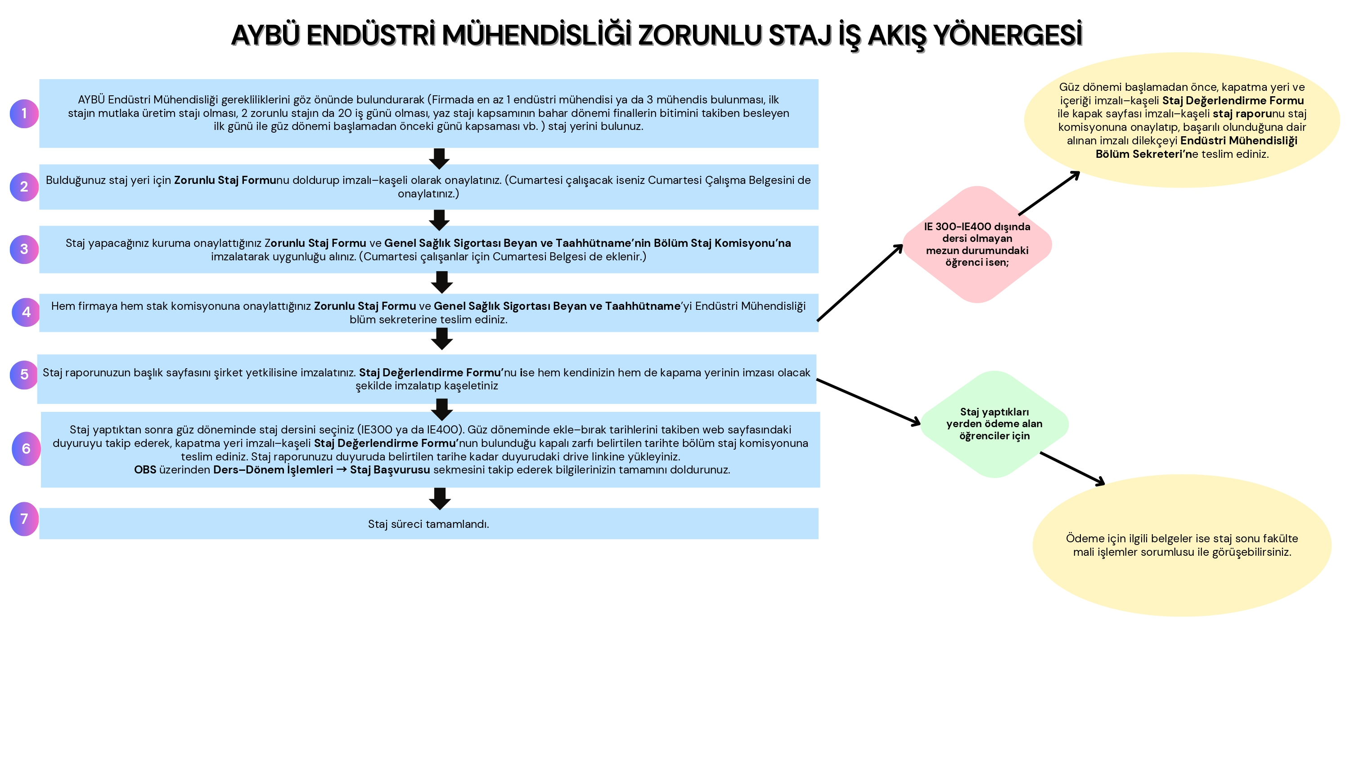

Slide 3
General Info
2 Internship! – IE300 and IE400 (each 20 working days)
Production-Service (OR Production-Production(not preferable)) (At least 1 Production/1st one)
3 Engineers OR 1 Industrial Engineer
You will find THE COMPANY BY YOURSELF

Slide 4
1.BEFORE INTERNSHIP

Slide 5
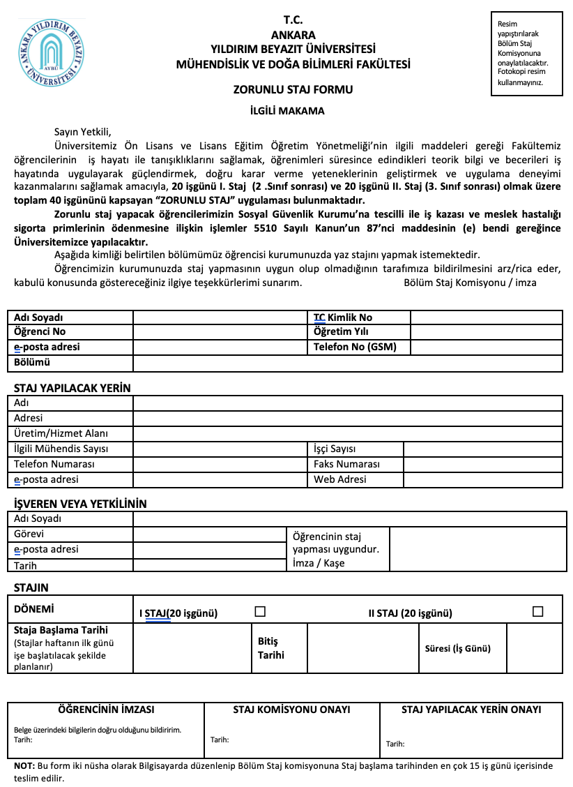
Before Internship
3 documents!!!
Document link: https://aybu.edu.tr/endustrimuh/tr/sayfa/2040/Staj-Formlar%C4%B1
“Zorunlu Staj Formu” (2 copies) (The company will sign and stamp it.)
Forms must be completed fully in electronic format. Forms completed by hand will result in the documents being returned.
Official public holidays, such as July 15 and August 30, must be excluded from the 20 working-day calculation when determining the internship end date.

Slide 6
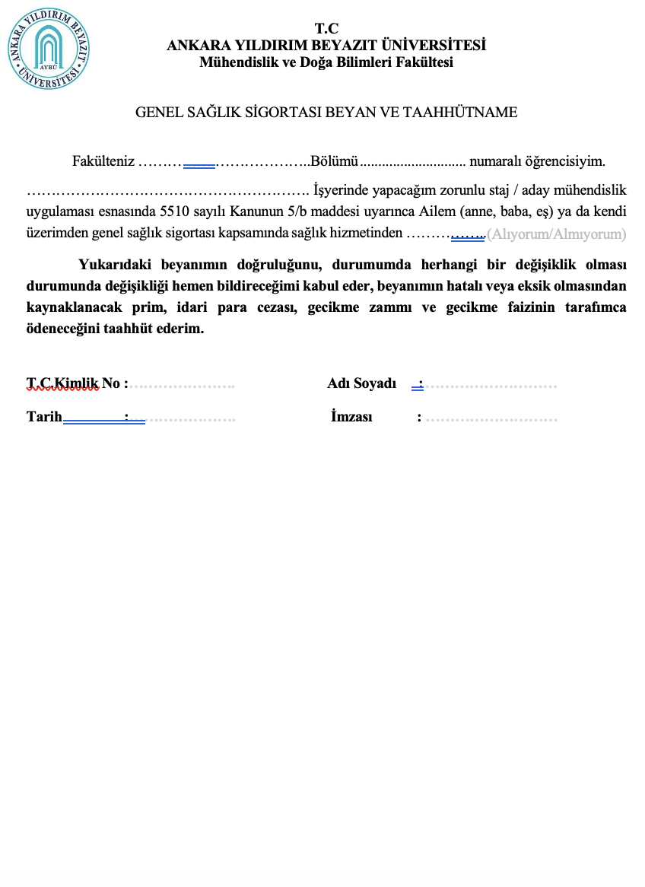
Before Internship (cont.)
2. “Genel Sağlık Sigortası Beyan ve Taahhütname”
Almıyorum – I/my family do not work at insured job.
Alıyorum - I/my family work at insured job.

Slide 7
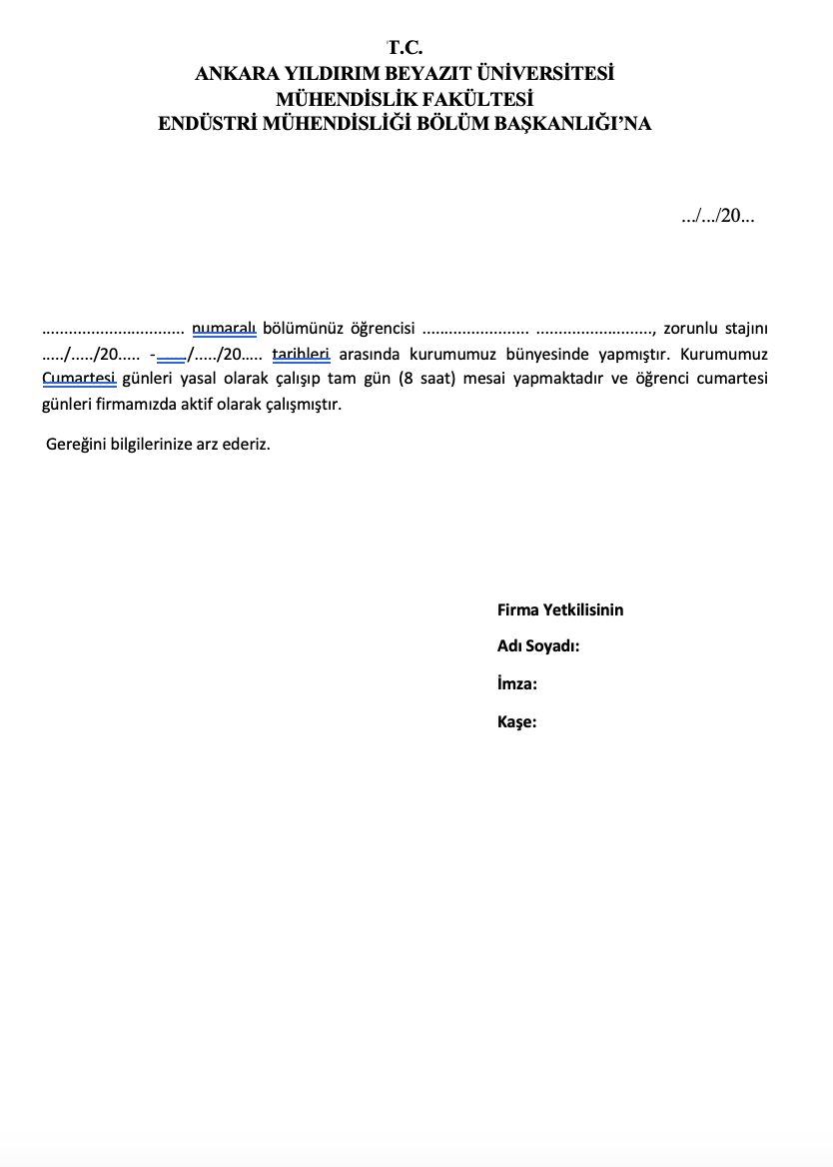
Before Internship (cont.)
3. “Cumartesi çalışma belgesi”
(not compulsory)
If you work on Saturday.

Slide 8
1. Internship documents must first be checked by Dr. Yağmur Arıöz or Dr. Emine Nur Nacar.
2. After obtaining their signatures, please submit the documents to the department secretary, Uğur Kırbağ.

Slide 9
Before Internship (cont.)
Documents must be submitted no later than two weeks before the internship start date.
Given that the academic calendar begins on September 21, the final deadline for document submission to our office is August 10.
Internship documents will only be accepted on Tuesdays between 11 a.m. and 12 p.m. In case of any changes, you will be informed.(Office number: B519)
Responsible from Internship: Dr. Emine Nur Nacar, Dr. Yağmur Arıöz

Slide 10
Communication tools
Do not use communication tools such as mail, WhatsApp, or phone calls!!! For your questions, come on the relevant day and time.

Slide 11
2.AFTER INTERNSHIP

Slide 12
After Internship
1.“Staj Degerlendirme Formu”
2. Internship questions (Production/Service)+Internship report

Slide 13
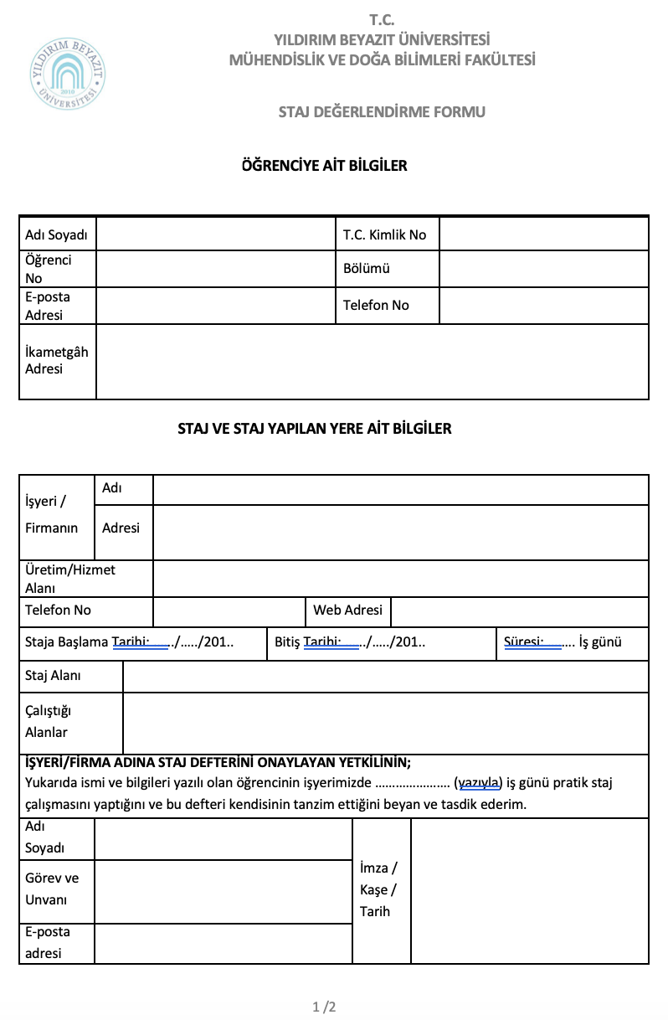
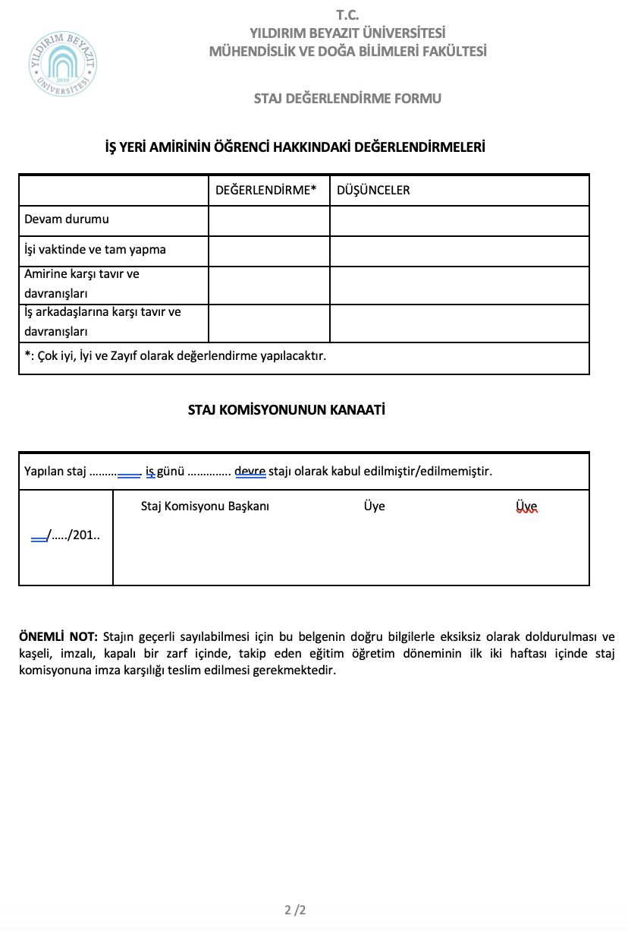
After Internship
(cont.)
1. Submit this document in a sealed envelope.

Slide 14
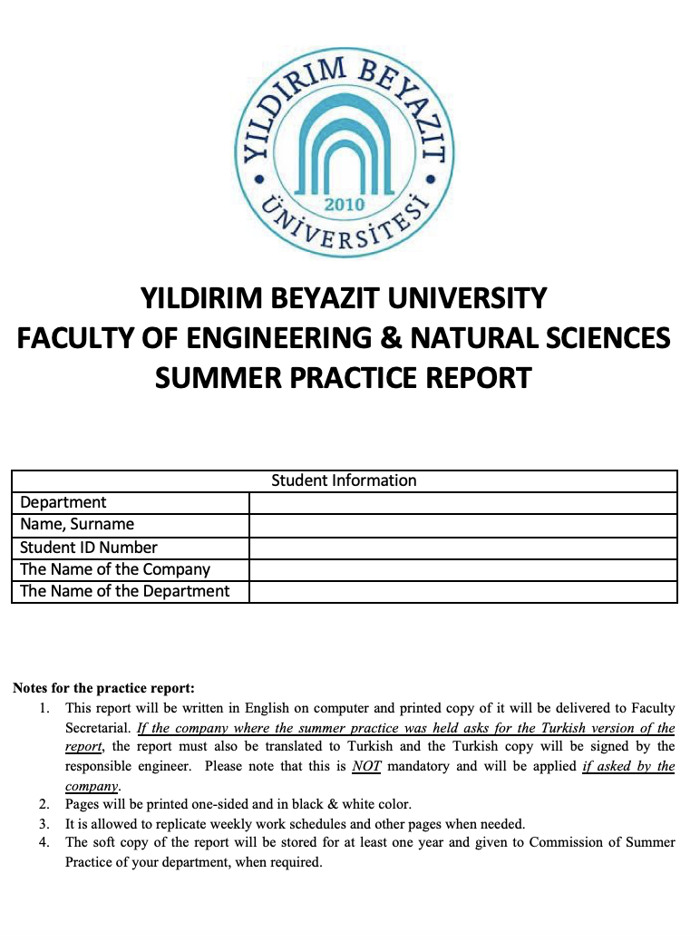
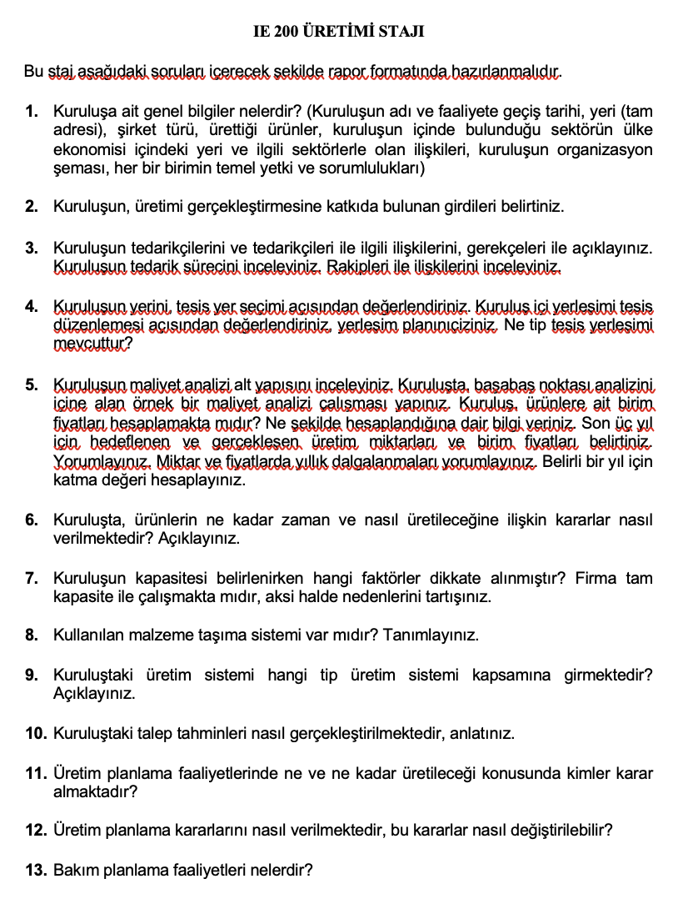
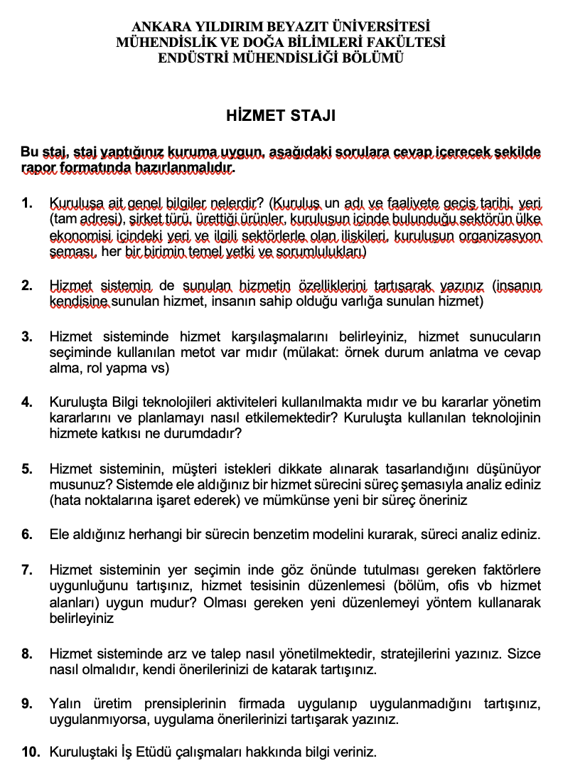
After Internship (cont.)
2. Internship questions (Production/Service)
+
Internship report
OR

Slide 15
After Internship (cont.)
“Staj Degerlendirme Formu”
It will be hand delivered to Dr. Emine Nur Nacar or Dr. Yağmur Arıöz in the first week of November.
2. Internship questions (Production/Service)
+
Internship report
Two documents will be prepared. It will be uploaded as a single pdf to the Drive link below in the first week of November.

Slide 16
3. Voluntary internship/
Unpaid internship (Gönüllü Staj)

Slide 17
3.Voluntary internship/ Unpaid internship (Gönüllü Staj)
Students are eligible to undertake a voluntary internship only after completing the two mandatory internships.(IE300 and IE400)
Students are required to submit a printed copy of their transcript, obtained from the faculty or through e-Devlet, to Dr. Yağmur Arıöz or Dr. Emine Nur Nacar.

Slide 18
4. Long-term Voluntary Internships and
ENGR 450 Candidate Engineering

Slide 19
4. Long-term Voluntary Internships and
ENGR 450 Candidate Engineering
Long-term voluntary internships and ENGR 450 Candidate Engineering are outside the scope of the Internship Commission.
Students concerned must contact their academic advisors and manage the process in coordination with them.

Slide 20
5. ERASMUS Internship
All processes are carried out through the AYBU Erasmus Office.

